Slide 1
Section 2
Introduction to Artificial Intelligence

Slide 2

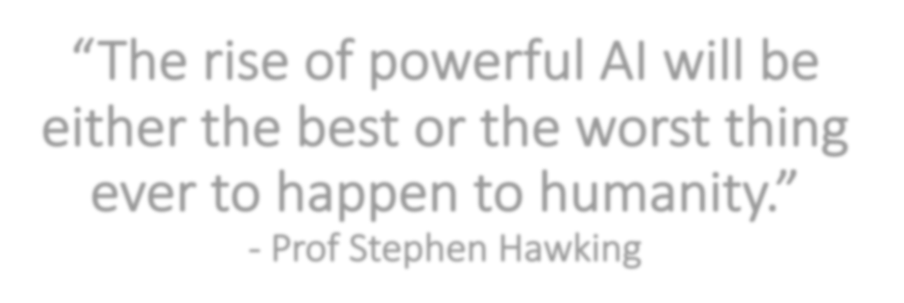

“The rise of powerful AI will be either the best or the worst thing ever to happen to humanity.”
- Prof Stephen Hawking

Slide 3
What’s Artificial Intelligence (AI) – Definition from dictionaries
“The theory and development of able to perform tasks
computer systems
normally requiring human intelligence, such as
visual perception, speech
recognition, decision-making, and translation between languages
.”
– Oxford Dictionary
“The study of how to produce
machines
that have some of the qualities that the
human mind has, such as the ability to
understand language, recognize pictures,
solve problems, and learn”
– Cambridge Dictionary
do intelligent things that people can do,
“The study of how to make
computers
such as and
”
think
make decisions
– Longman Dictionary

Slide 4
What’s Artificial Intelligence (AI) – Definition in AI-900
Artificial intelligence (AI) is the capability of a computer to imitate intelligent human behavior.
Make Predictions
Detect Anomalies
Analyze Images
Comprehend Speech
Interact in Natural Ways
Cognition
Vision
Hearing
Language

Slide 5
Introduction to Machine Learning
Machine Learning
A data science technique that allows computing resources to use historical data to create a model to forecast future behaviours, outcomes, and trends.
Purpose - Forecasts / Predictions
Register Data
Build & Train Model
Evaluate Model
Deploy Model

Slide 6

Machine Learning (ML) is the foundation of an AI system
Prediction/Forecasting
Anomaly Detection
Computer Vision
Natural Language Processing
Conversational AI
Build, Train, Deploy Models
Neural Network
Artificial intelligence
Machine Learning
Deep Learning

Slide 7
Common
AI Workloads

Slide 8
Prediction/Forecasting in AI
Workloads
Prediction of the global growth and trend of COVID-19 pandemic
Prediction of a disease diagnosis based on symptoms and medical history
Prediction of the future levels of carbon dioxide (CO2) in the atmosphere
Weather prediction/forecasting
Predict application workload and performance for resource management
Predict sales of cars next month based on historic data
Predict home prices next year
Predict the travel time/fastest route using a navigation app
Azure Services
Machine Learning

Slide 9

Anomaly Detection in AI
Workloads
Identifying suspicious logins by looking for deviations from normal activities
Identifying suspicious behaviors by detecting too many failed login attempts
Monitoring machines’ temperature in the factories
Detecting irregular heart beats using a health monitoring system in the hospital
Detecting fraud in credit card transactions in the Banking systems
Azure Services
Cognitive Services
Decision
Anomaly Detector

Slide 10

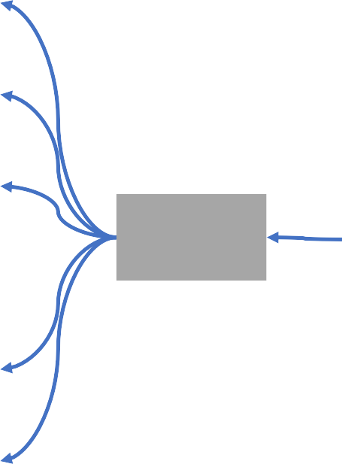

Computer Vision in AI – Overview
Image Classification
Object Detection
Azure Services
Image Analysis
Computer Vision
Cognitive Services
Semantic Segmentation
Vision
Face Detection, Analysis & Recognition
Optical Character Recognition (OCR)

Slide 11
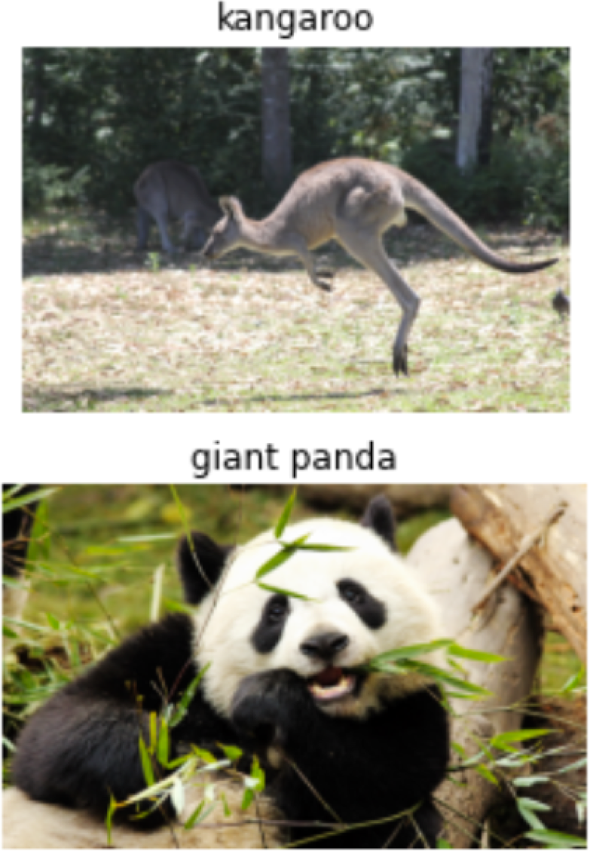
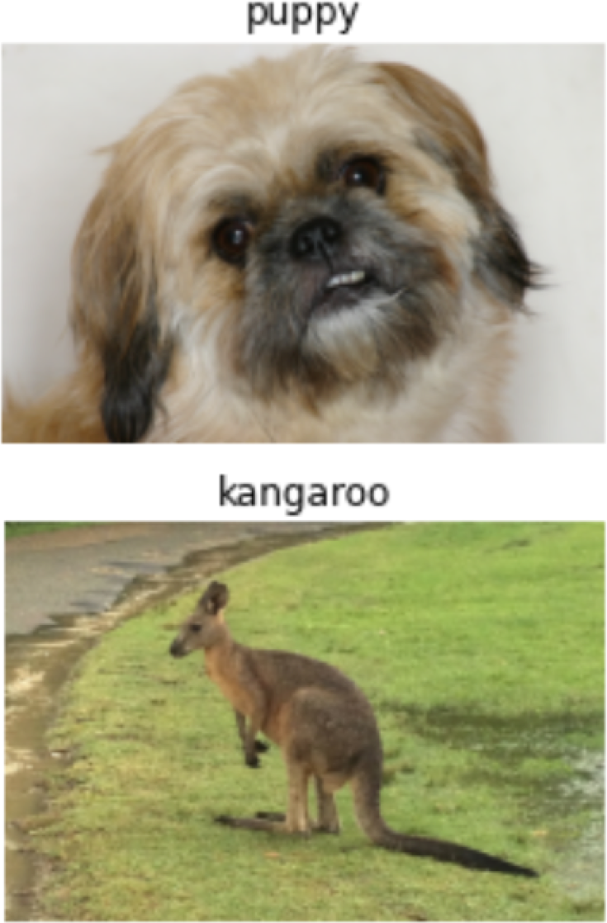
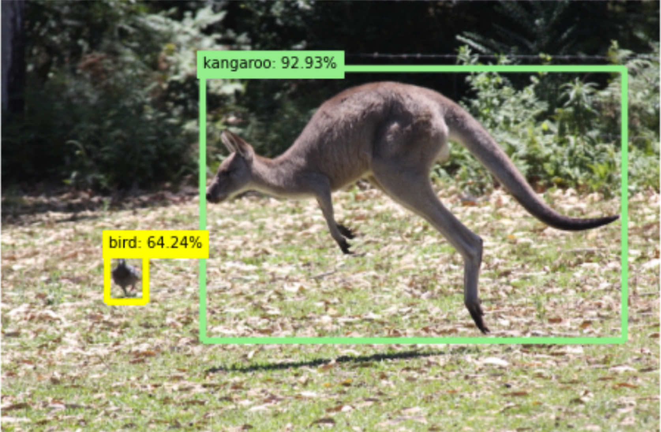
Computer Vision in AI – Image Classification & Object Detection
Image Classification | Object Detection
Classify images based on contents | Classify individual objects Identify object’s location Indicate a bounding box

Slide 12
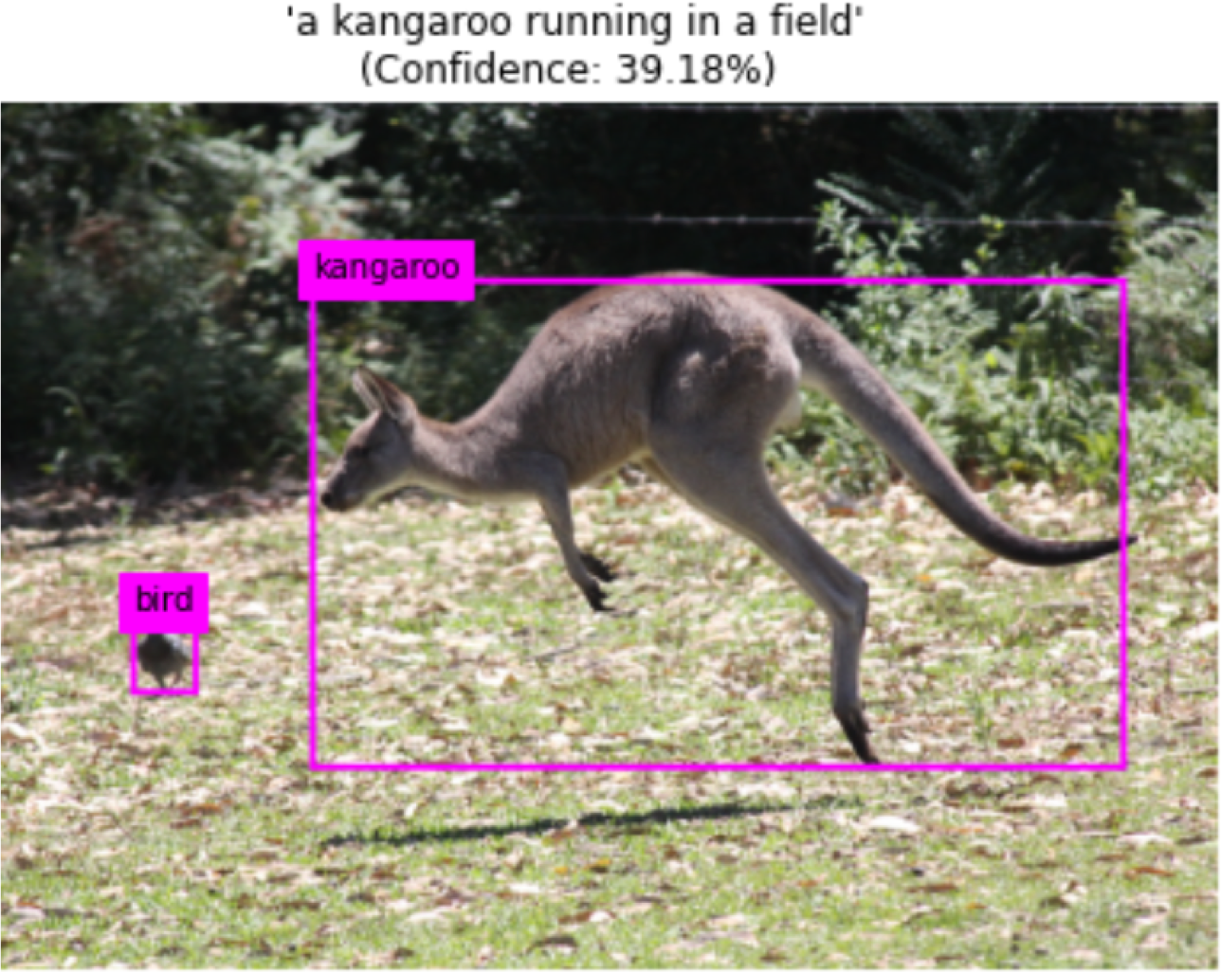
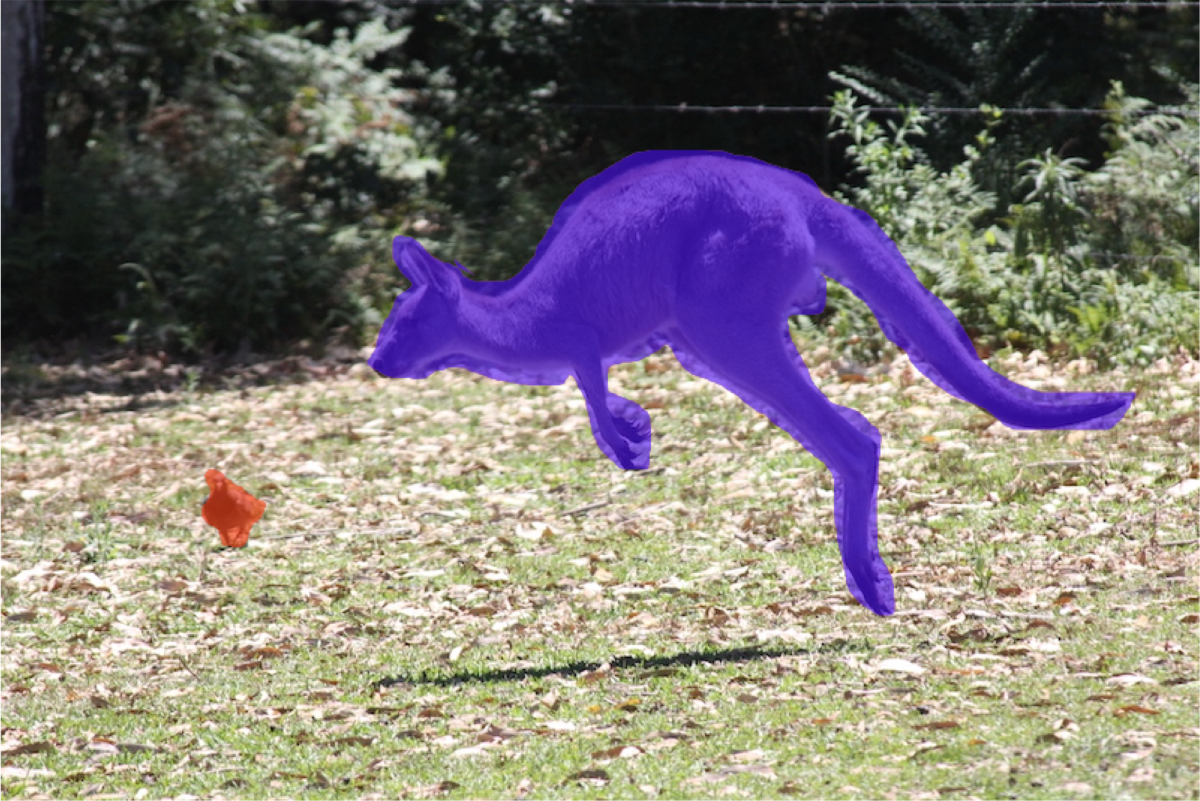
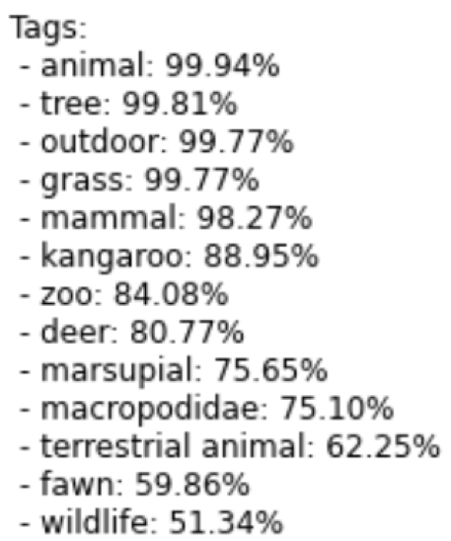
Computer Vision in AI – Image Analysis & Semantic Segmentation
Image Analysis | Semantic Segmentation
Extract information from images Return ‘tags’ with ‘confidence’ Summarize the scene with a descriptive caption | An advanced ML technique – label every pixel Locate objects and shapes Return a mask layer of objects

Slide 13
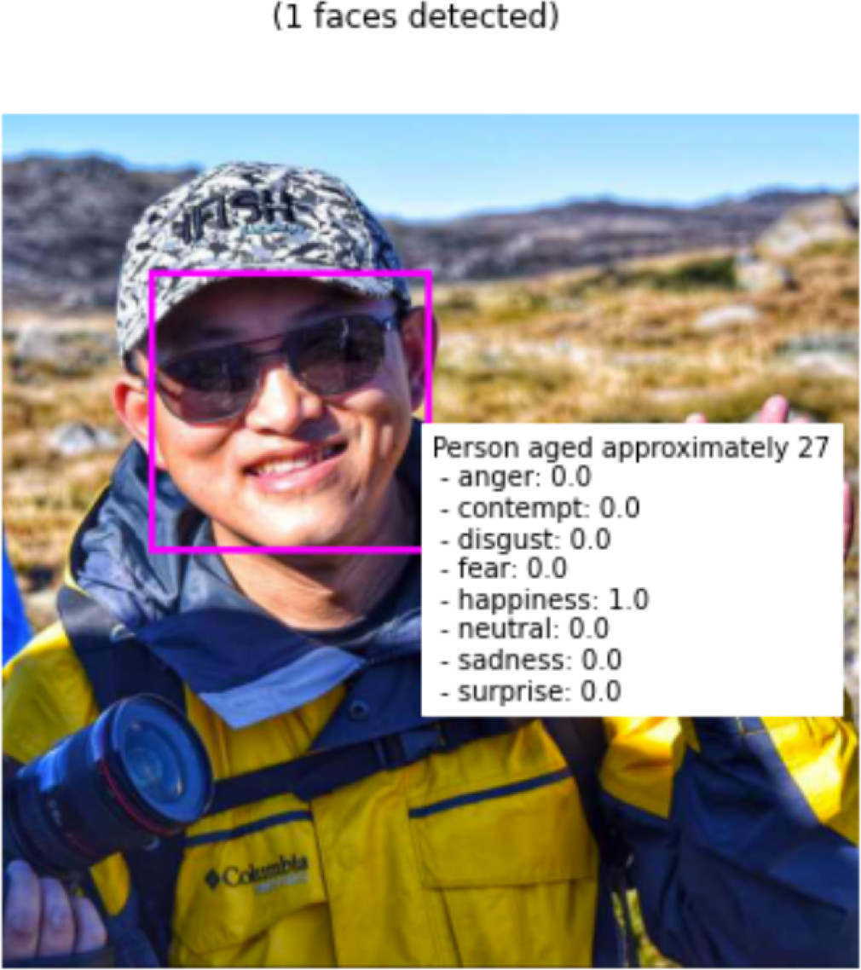
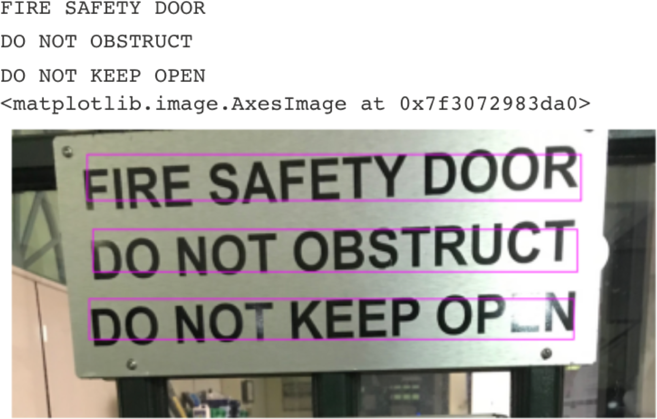
Computer Vision in AI – Face Detection & OCR
Face Detection, Analysis & Recognition | Optical Character Recognition (OCR)
Specialized form of object detection Locate human faces with a bounding box Suggest age and emotional state Identify or verify the identity of an individual | Recognise text in images (photos or scanned documents) Convert printed or handwritten text characters into text data

Slide 14

Natural Language Processing (NLP) in AI
Natural Language Understanding (NLU)
Read
Interpret
Azure Services
Natural Language Processing (NLP)
Language
Cognitive Services
Speech
Natural Language Generation (NLG)
Write
Generate

Slide 15
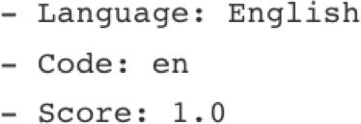

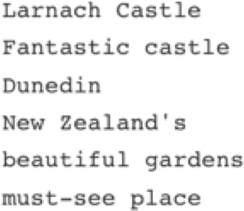
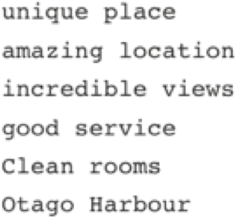
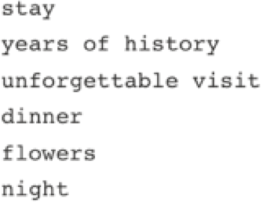

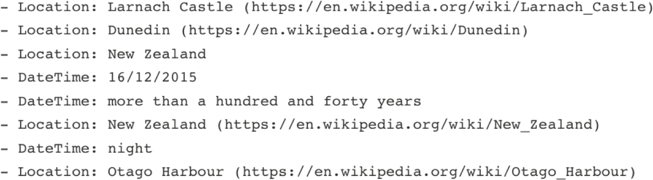
Natural Language Processing (NLP) in AI – NLU
Text Interpretation | Speech Recognition
Analyze and interpret text in documents | Interpret spoken language
Fantastic castle and beautiful gardens Larnach Castle, Dunedin, New Zealand 16/12/2015 This is a unique place with more than a hundred and forty years of history. It's called New Zealand's only Castle. It's a must-see place in Dunedin. We stayed a night. We really enjoyed our stay at Larnach Castle. Clean rooms, good service, amazing location with incredible views of the Otago Harbour. The dinner was fantastic. We also really enjoyed exploring the gardens and flowers. It's an unforgettable visit. | Audio | Text “Hello everyone.” “To be or not to be? That is the question. Whether TIS nobler in the mind to suffer the slings and arrows of outrageous fortune, or to take arms against a sea of troubles, and by opposing end them.”
Key Phrases
Determine Sentiment
Extract Known Entities

Slide 16
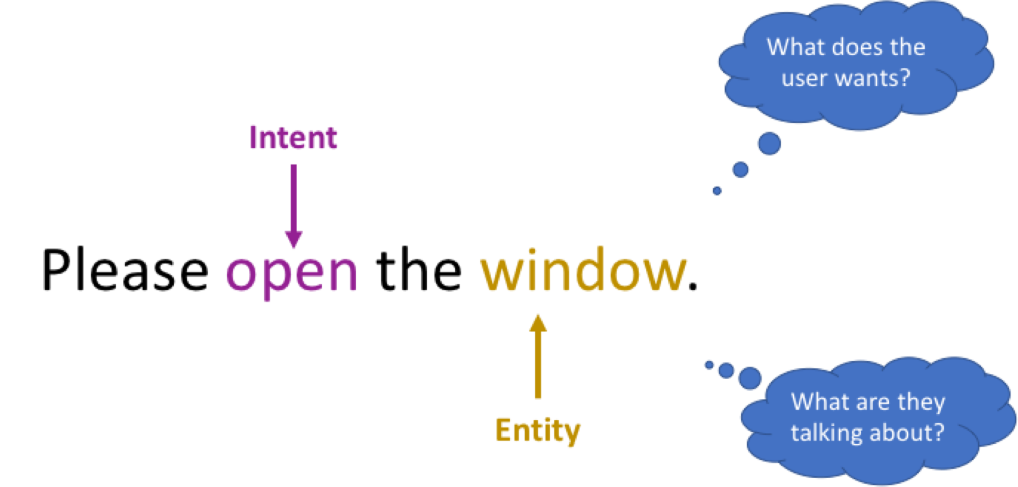


Natural Language Processing (NLP) in AI – Intent Recognition
Commands Interpretation / Intent Recognition
Interpret commands and determine appropriate actions
Please open the door Could you open the gate Please close the gate Could you close the door Turn on the light please Please switch the lamp on Turn off the light please Please turn the lamp off Switch on the fan please Please turn the AC on Switch off the fan please Please turn the AC off

Slide 17






Natural Language Processing (NLP) in AI - NLG
Speech Synthesis | Translation
Synthesize speech responses | Translate spoken or written texts
Text Audio | Text Translation Text to Text Text to Speech Speech Translation Speech to Speech Speech to Text | English to French: Hello -> Bonjour Hello -> -> -> Hello -> Bonjour
“Turning the light off.”
“To be or not to be? That is the
question. Whether tis nobler in
the mind to suffer
The slings and arrows of
outrageous fortune, Or to take
arms against a sea of troubles
And by opposing end them.”

Slide 18
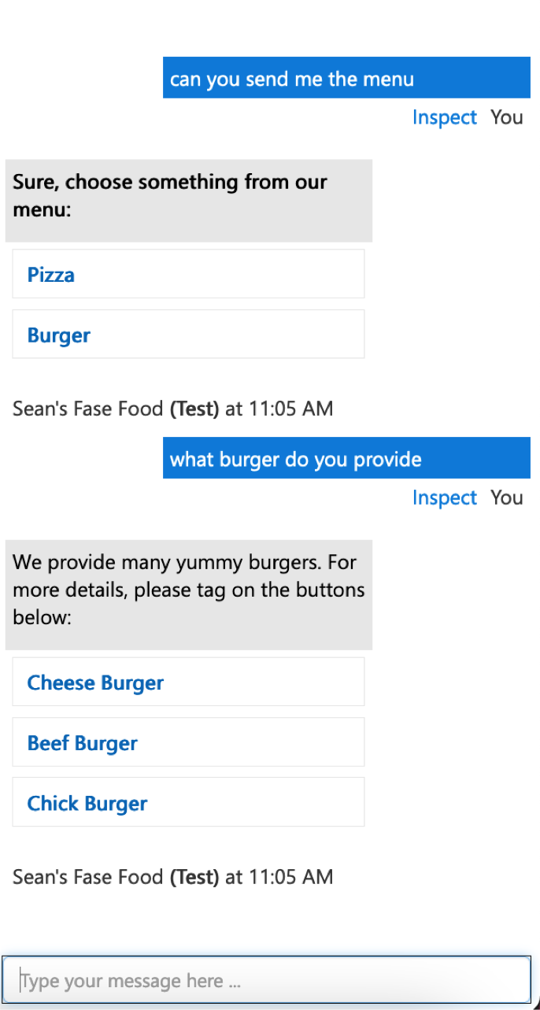

Conversational AI
AI agents participate in conversations with humans
Conversation AI Scenarios
Chatbots
IBM Watson Assistant
Home automation / Smart home
Smart personal assistant / Virtual assistants
Siri, Alexa, Google Assistant, Cortana, etc.
Azure Services
QnA Maker
Bot Services
Turing Test
Machine or Human?

Slide 19
Principles of Responsible AI

Slide 20




















Six Ethics Principles of Microsoft Responsible AI
Fairness
Reliability & Safety
Privacy & Security
Inclusiveness
Transparency
Accountability
Responsible AI
To build a trust, reliable, safe and secure AI

Slide 21
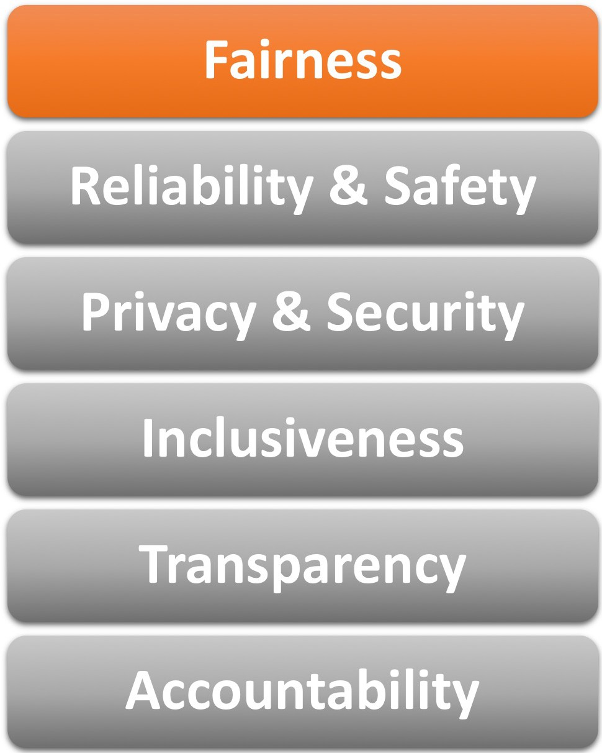
Ethics Principles of Responsible Al
Treat all people fairly
Scenarios
Al based Supermarket Surveillance
Al based banking home Loan application
Al based interview application

Slide 22
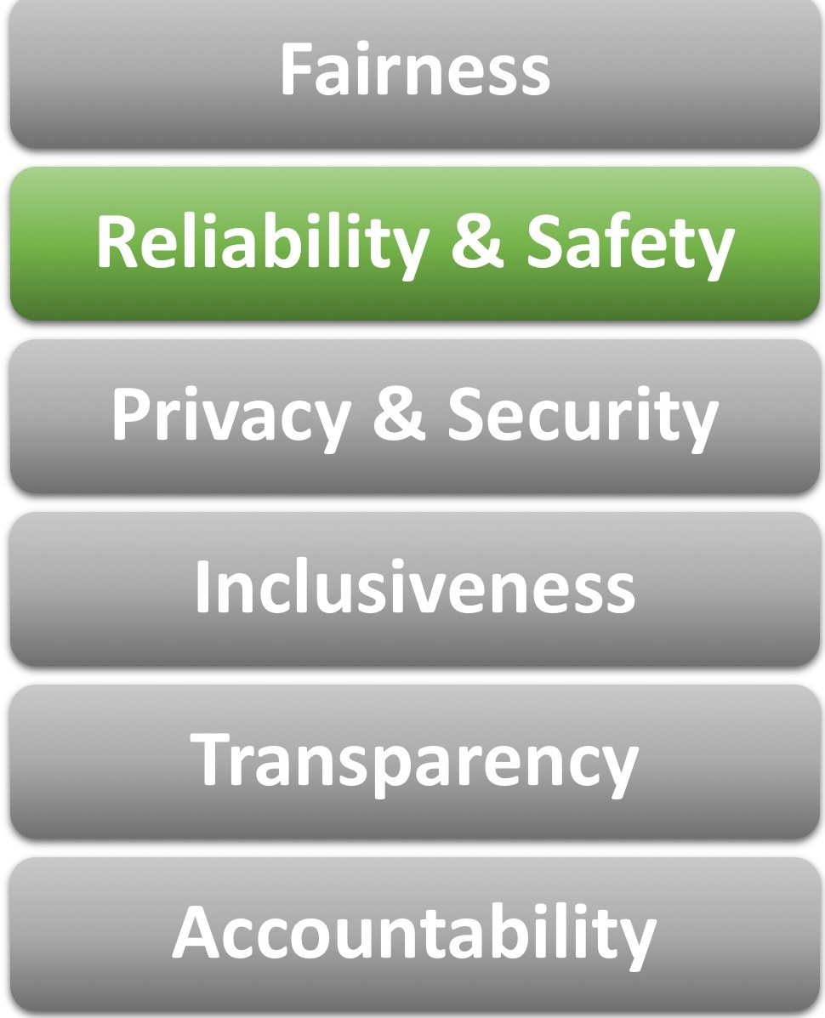
Ethics Principles of Responsible Al
Perform reliably and safely
Scenarios
Operate as the intended purpose
Handling of unexpected circumstances
Handling of missing data/unusual input
Handling of corruption of system
Safety of self-driving cars

Slide 23
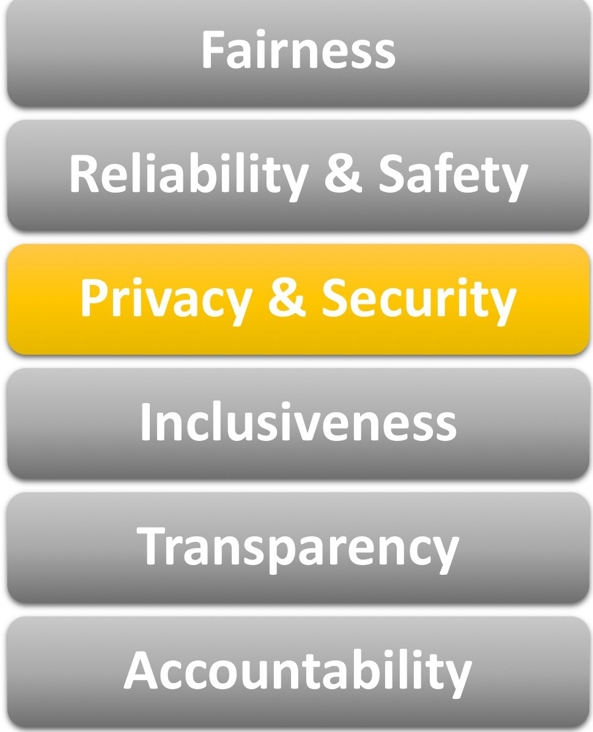
Ethics Principles of Responsible Al
Secure and respect privacy
Scenarios
Run the model locally without storing data
Prevent data leakage
Data Anonymization
Implement security measures

Slide 24
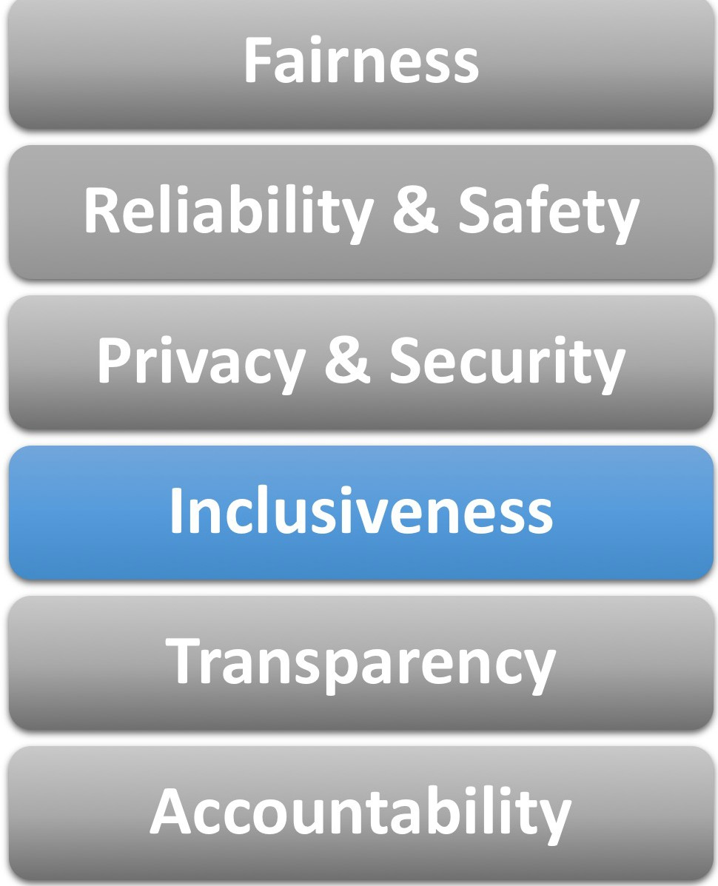
Ethics Principles of Responsible Al
Empower everyone and engage people
Scenarios
Include people who have vision and hearing impairment
Avoid any specific individual, user groups or communities being left out

Slide 25
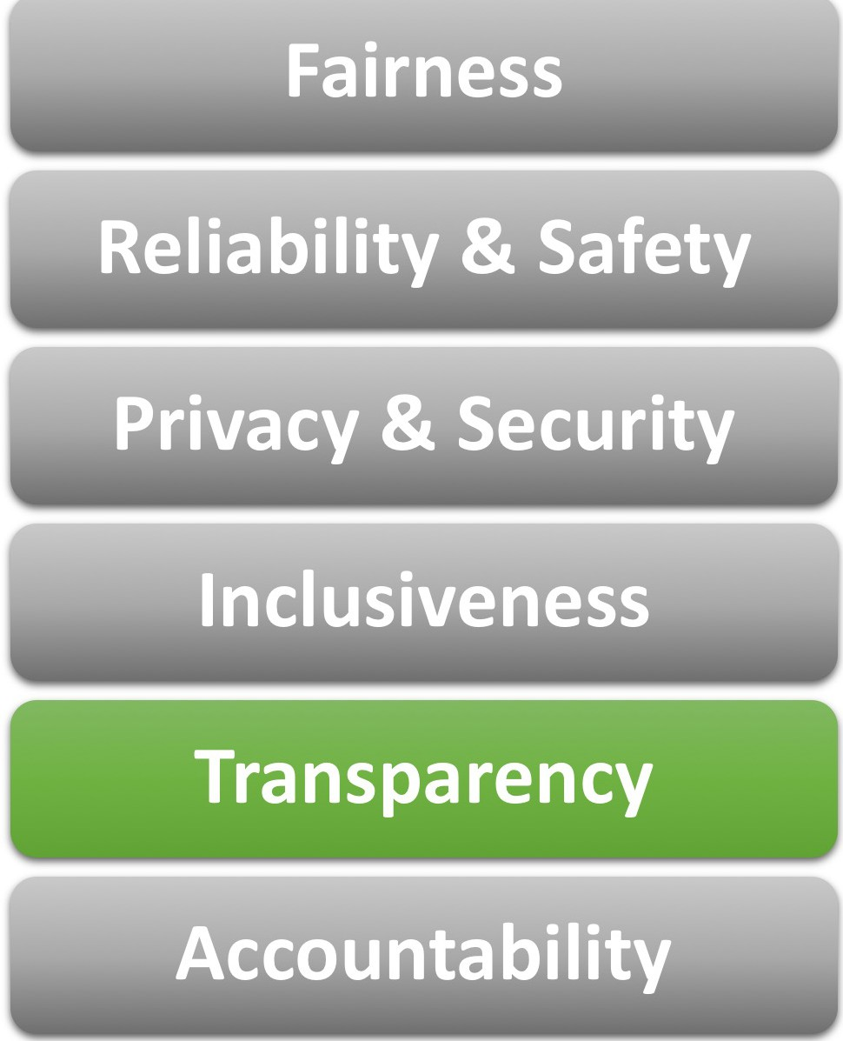
Ethics Principles of Responsible Al
Be understandable
Scenarios
Clear the purpose of the Al system
Explain how the Al system operates
Understand the behaviors
Ensure users are aware of the limitation of the system

Slide 26
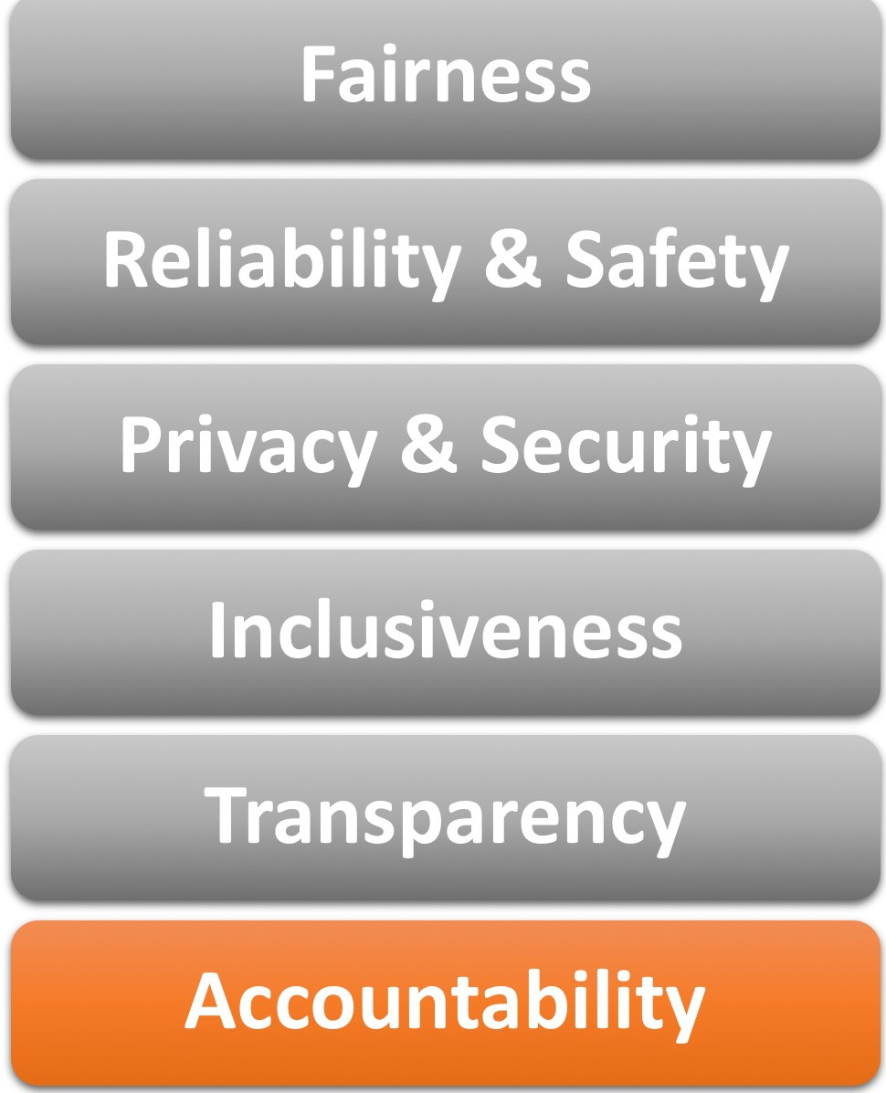
Ethics Principles of Responsible Al
People should be accountable for Al systems
Scenarios
Designers and developers work within a framework of governance and organizational principles
Make company policies clear and accessible to design and development teams
Ensure the systems meet ethical and legal standards
Al systems can be overridden by humans

Slide 27
Artificial Intelligence Summary

Slide 28




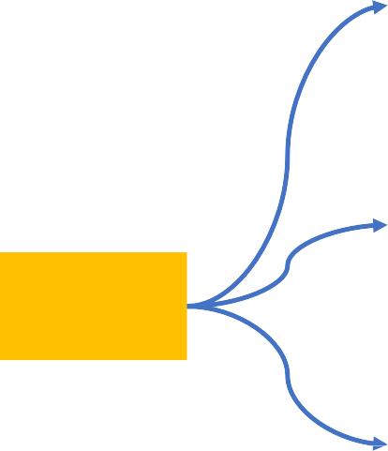





Azure AI + ML Services in AI-900
ML Workspace
AutoML
ML Designer
ML Studio
Machine Learning
Computer Vision
Vision
Custom Vision
Face
Cognitive Services
Language
Form Recognizer
Text Analytics
AI-900
Speech
Language Understanding
Bot Services
Translator
Decision
QnA Maker
Speech to Text
Fairness
Reliability & Safety
Privacy & Security
Inclusiveness
Transparency
Accountability
Responsible AI
Text to Speech
Speech Translation
Anomaly Detector
Content Moderator

